Slide 1
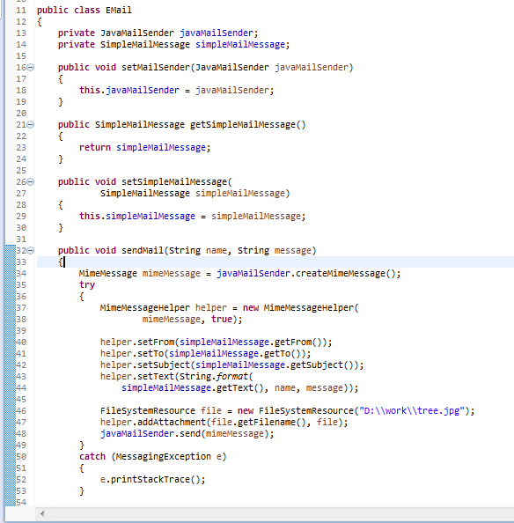
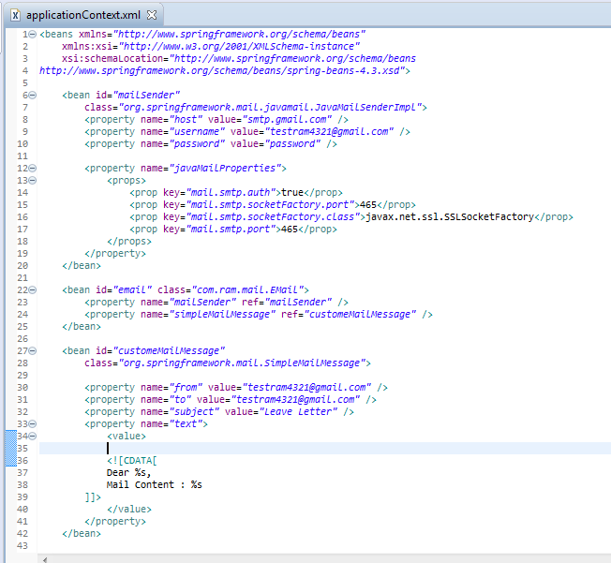
Sending e-mail with attachment
Spring to send e-mail that has attachments via Gmail SMTP server. In order to contains the attachment in your e-mail, you have to use Spring’s JavaMailSender & MimeMessage , instead of MailSender & SimpleMailMessage.

Slide 2
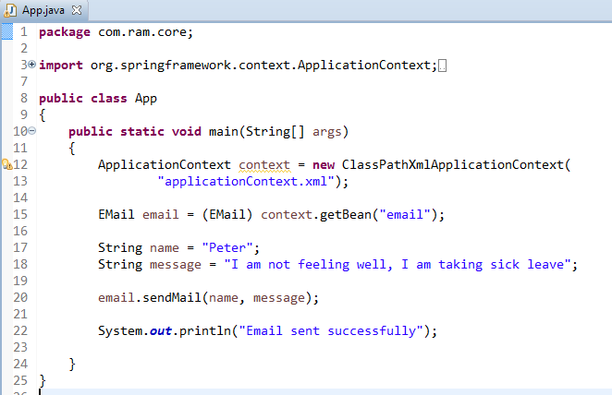
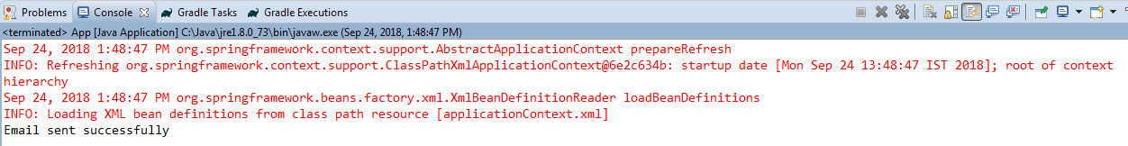
Sending e-mail with attachment

Slide 3
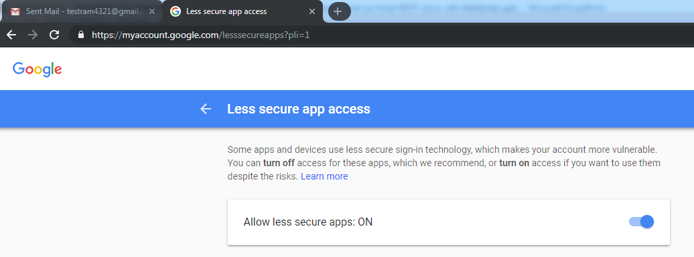
Sending e-mail with attachment
To resolve javax.mail.AuthenticationFailedException is thrown while sending email in java
Go Login from Your browser from that email. I had problem with google if it is google go here :https://www.google.com/settings/security/lesssecureapps
you will see turn off or turn on. Click "Turn on"
Then try your code again it will work

